Slide 1
PGB Session
30 January 2025
Ms. Katherine Escobar
NIEMOpen Project Governing Board Chair

Slide 2
Call to order
Called to order the regular virtual meeting of the NIEMOpen Project Governing Board at 2 PM, 30 January 2025.
Notes:
Chair: This meeting is being recorded for the record and a link will be provided in the minutes.

Slide 3
Venue
Microsoft Teams 30 January 2025 PGB Meeting
PGB Meeting
30 January 2025
Virtual Meeting 2-4 PM EST
Virtual: MS TEAMS
Microsoft Teams 30 January 2025 PGB Meeting
Join the meeting now
Meeting ID: 993 967 584 930
Passcode: JTiu7a
Dial in by phone
+1 410-874-6749,,296683050# United States, Odenton
Find a local number
Phone conference ID: 296 683 050#
PGB Minutes & documents: https://github.com/niemopen/oasis-open-project/tree/main/pgb-meeting-minutes

Slide 4
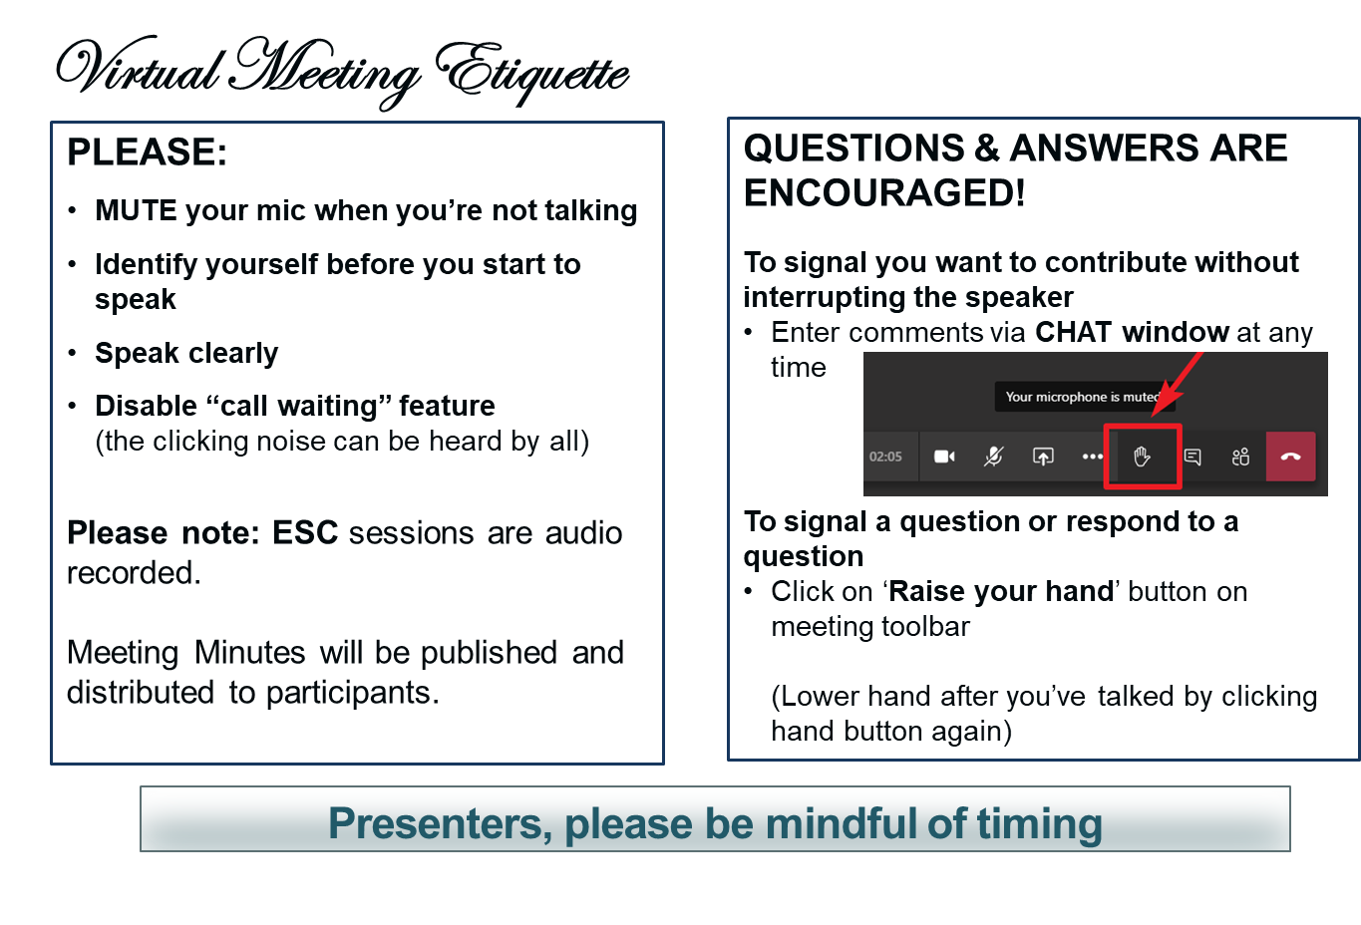
Making the most of our session
Notes:
VOTING: The usual method of voting is viva voce (by voice). To accommodate the virtual setting the chair may ask members to “Raise your hand” to signal aye or no.

Slide 5
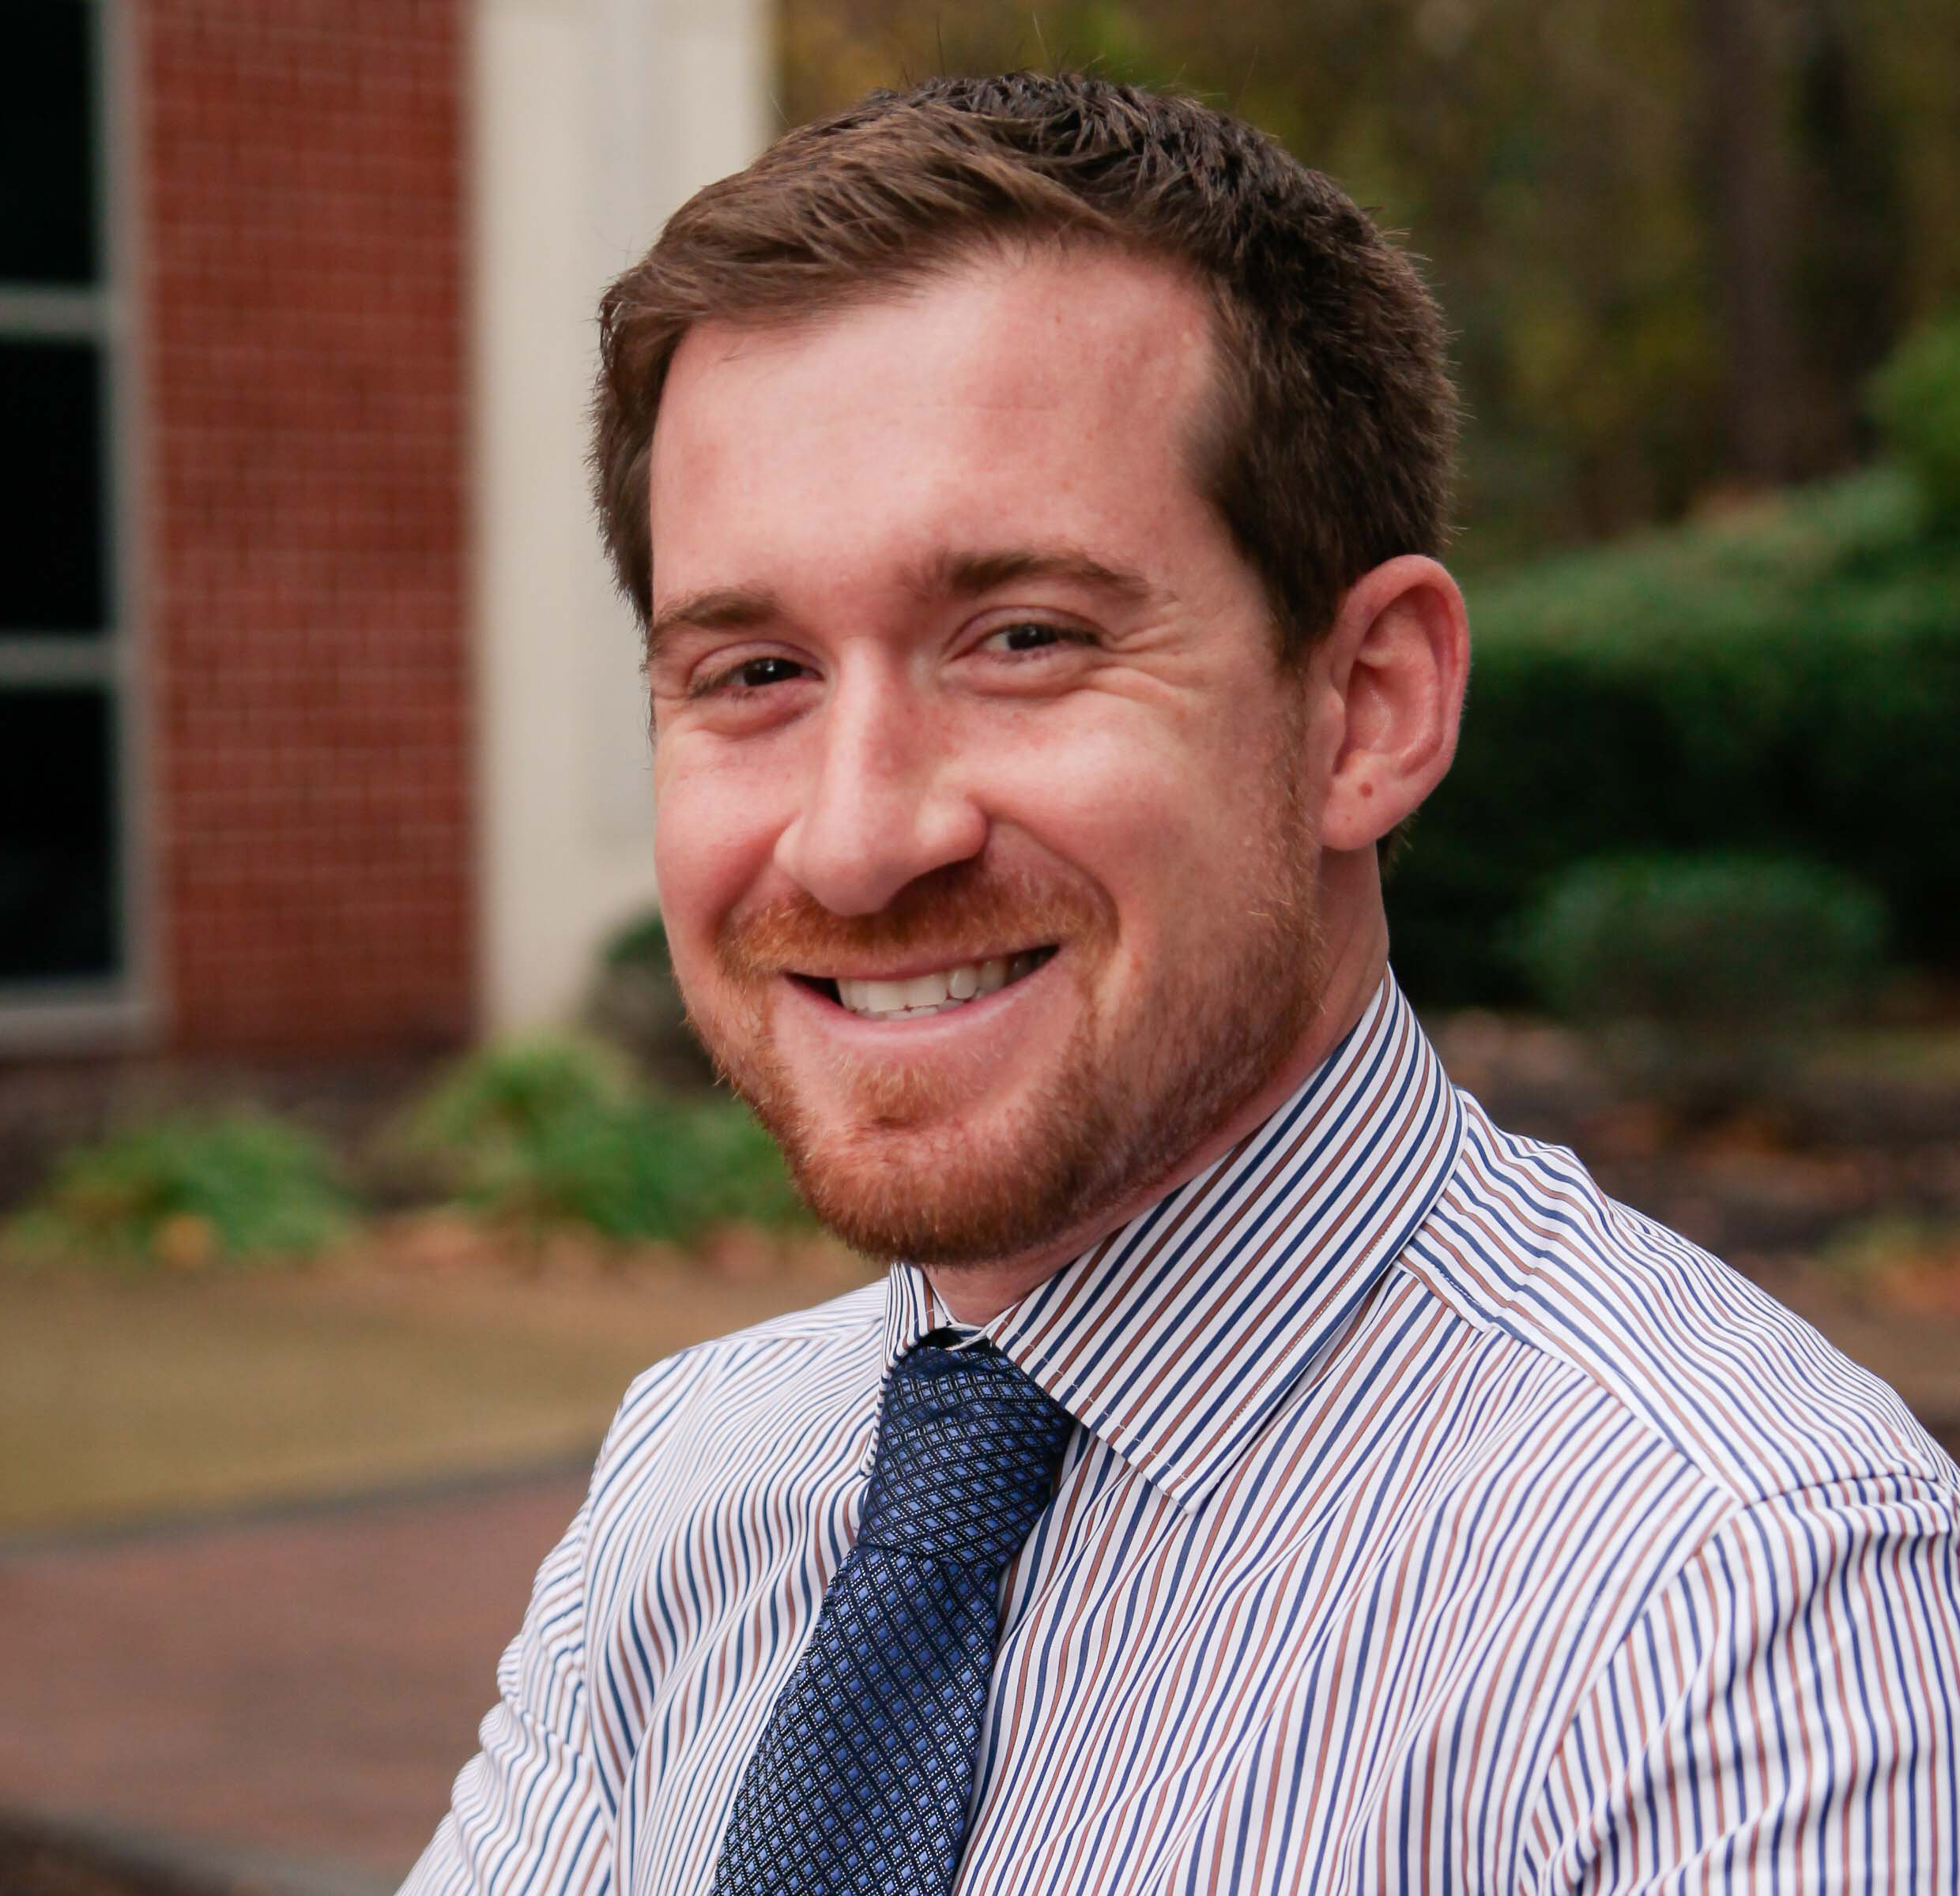
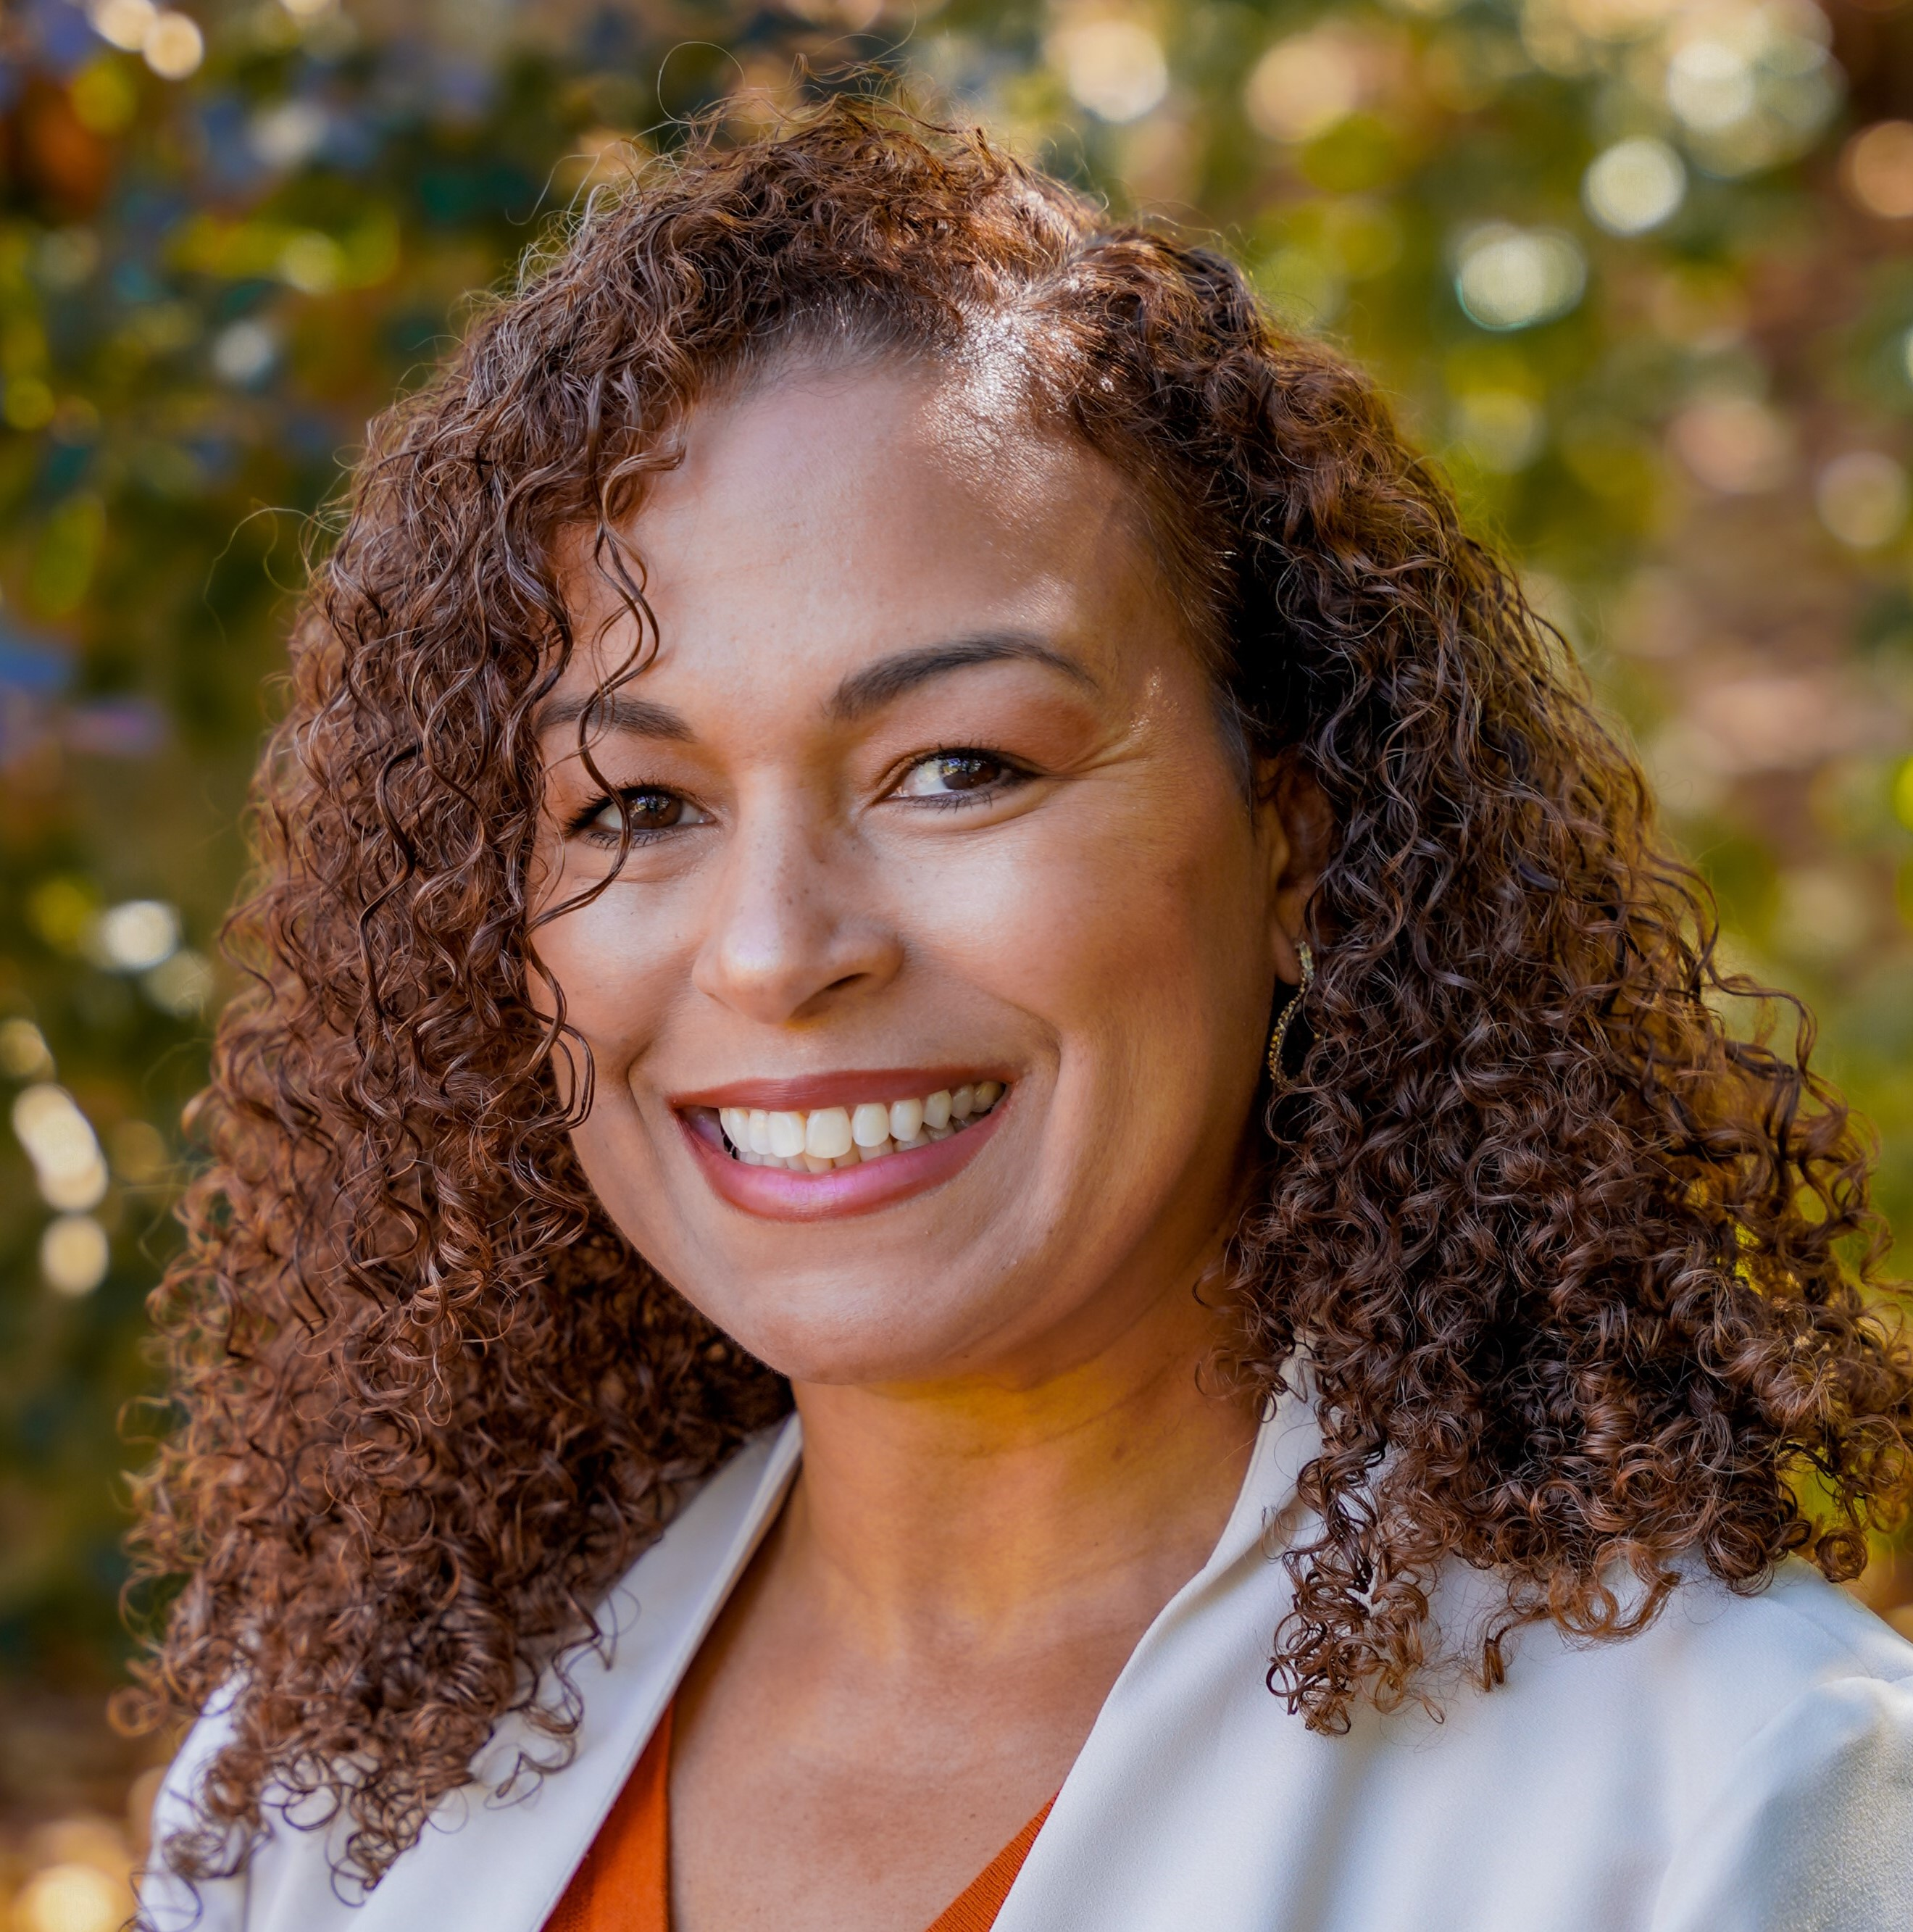
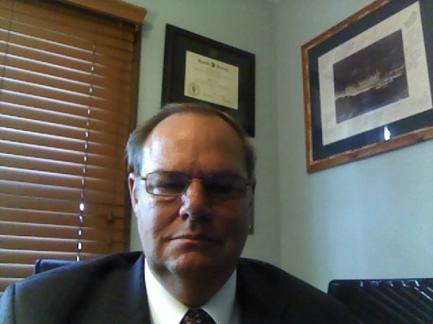
Note taker
The PGB Executive Session is being recorded on MS TEAMS. A link to the recording will be provided and meeting minutes will be posted on the NIEMOpen Git Repo once approved: https://github.com/niemopen/oasis-open-project/tree/main/pgb-meeting-minutes
Meeting support, note takers:
Aubrey Beach
aubrey.l.beach.ctr@mail.mil
Shunda Louis
shunda.r.louis.ctr@mail.mil
Stephen Sullivan
stephen.m.sullivan14.ctr@mail.mil

Slide 6
Roll call
PGB Voting Members:
Department of Defense Joint Staff J6 (DoD JS J6)
Department of Homeland Security Science & Technology (DHS S&T)
Equivant
Georgia Tech Research Institute (GTRI)
Integrated Justice Information Systems Institute (IJIS)
Commonwealth of Virginia, Office of Data Governance and Analytics
Criminal justice Information Systems Division (CJISD), Federal Bureau of Investigation
National Institute of Justice (NIJ)
Bureau of Justice Statistics (BJS)
National Association for Justice Information Systems (NAJIS)
PGB Expert Voting Members
NBAC TSC
NTAC TSC
NMO TSC
PGB Expert NON-Voting Members
Notes:
Chair: Will the secretary call the role
PGB Voting Members:
Department of Defense Joint Staff J6 (DoD JS J6) – Ms. Katherine Escobar
Department of Homeland Security Science & Technology (DHS S&T) – Ms. Christina Bapst-Stump
Equivant – Mr. Gary Egner
Georgia Tech Research Institute (GTRI) – Mr. John Wandelt
Integrated Justice Information Systems Institute (IJIS) – Ms. Maria Cardiellos
Commonwealth of Virginia, Office of Data Governance and Analytics – Mr. Payton Lamb
Criminal Justice Information Services Division (CJISD), Federal Bureau of investigation, – April Mitchell
National Institute of Justice – Erin Partin
Bureau of justice Statistics – Erica Smith
National Association for Justice Information Systems(NAJIS) – Tom Welch
PGB Expert Voting Members
NBAC TSC – Mr. Thomas Krul
NTAC TSC – Dr. Scott Renner
NMO TSC – Ms. Beth Smalley (Joint Staff J6 DSD)
PGB Expert Non-Voting Members
NBAC TSC – Mr. Thomas Krul (National Defence Canada)
NTAC TSC – Mr. Brad Bolliger

Slide 7
Announcements
PGB approved NIEMOpen NDR v6.0 PSD01
Submitted for Publication to OASIS Library
Chair informed PGB of impending vote to approve NIEM Model v6.0 PS02 and submit for publishing

Slide 8
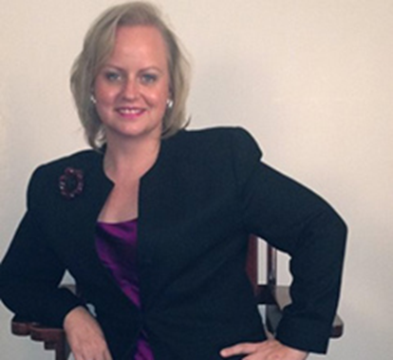
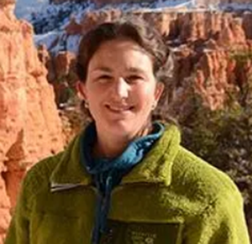

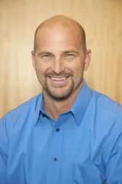
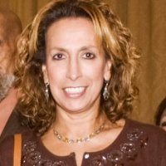
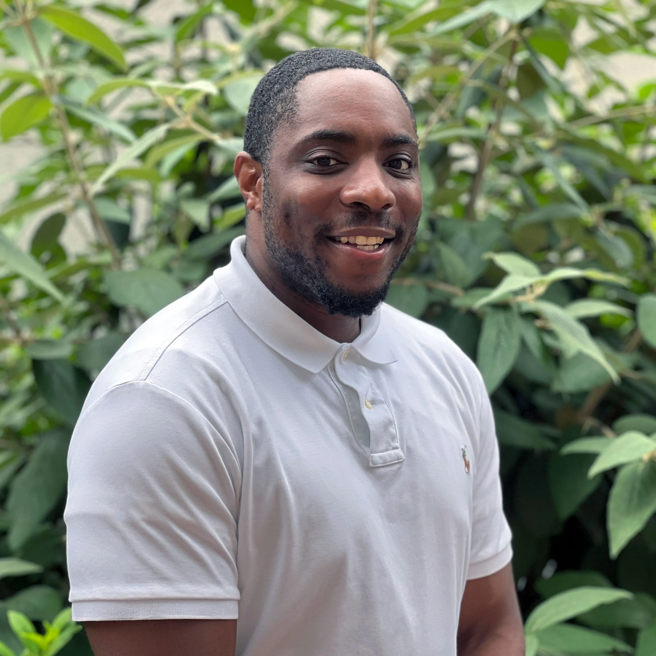
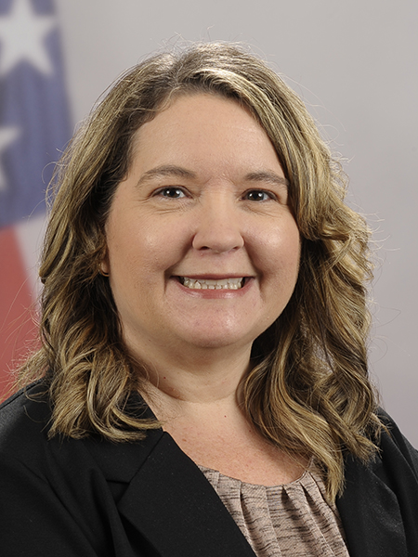
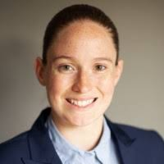
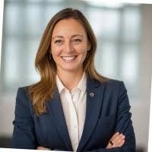
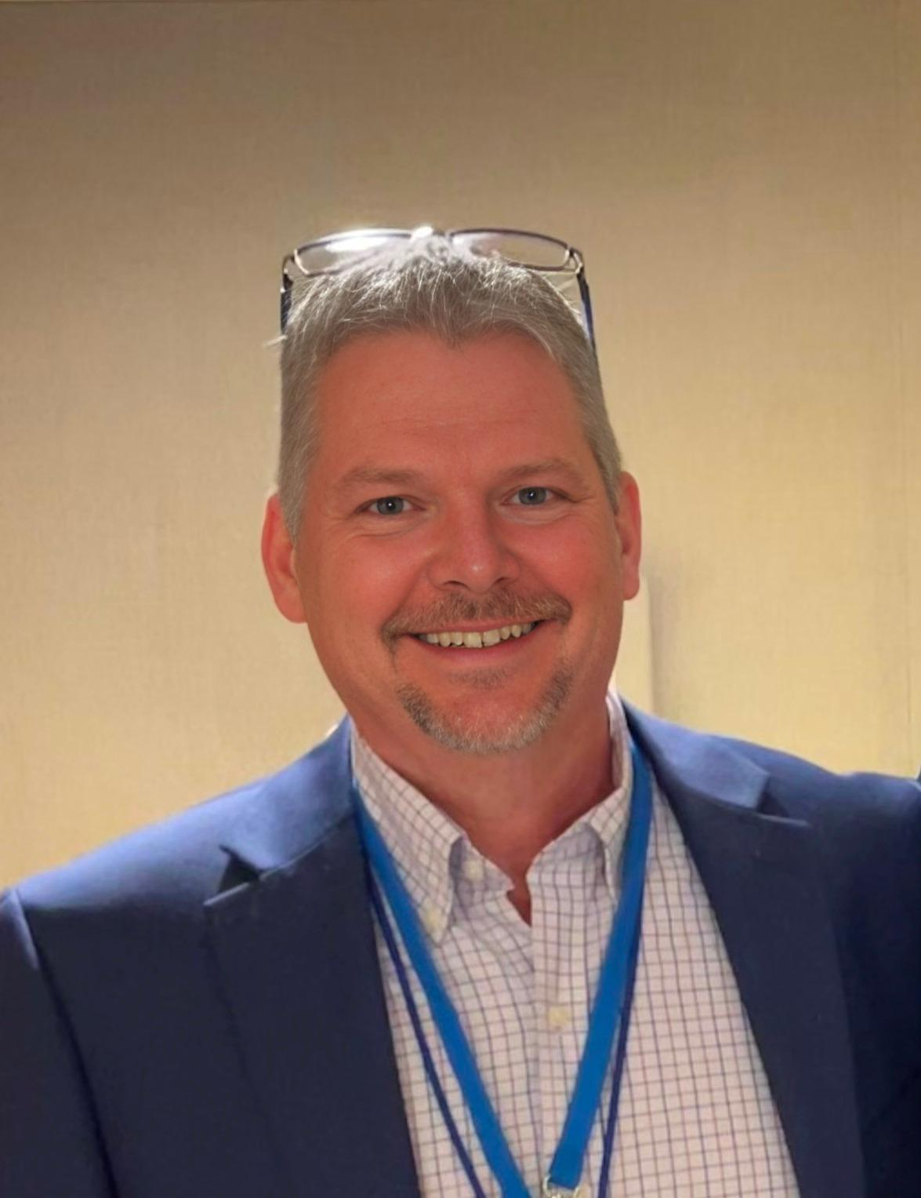
PGB APPOINTED VOTING MEMBERS
Ms. Katherine Escobar
PGB Chair
Deputy Division Chief, Data and Standards Division at Joint Staff J6 and NIEM Managing Director
Ms. Christina Bapst-Stump
Science and Technology Directorate, US Department of Homeland Security
Mr. Gary Egner
Director Business Development, Equivant
Mr. John Wandelt
Principal Research Scientist, Georgia Tech Research Institute
Ms. Maria Cardiellos
Executive Director
Integrated Justice Information Systems Institute
Mr. Payton Lamb
Data Engineer
Commonwealth of Virginia
Office of the secretary of Administration
Office of Data Governance and Analytics
Ms. April Mitchell
FBI It Specialist and Technical Lead of Data Standards in the Criminal Justice Information Services (CJIS) Division
Ms. Erin Partin
Data Scientist, Office of the Principal Deputy Director, National Institute of Justice (NIJ)
Ms. Erica Smith
Data Scientist, Unit Chief – Law Enforcement Incident-Based Statistics Unit, Bureau of Justice Statistics(BJS)
Mr. Tom Welch Director of Information Technology
OHIO HIDTA – Including Northern KY & Western PA
Notes:
Open Project Rules - OASIS Open (oasis-open.org)
5.1 Overall guidance for the Project is provided by its Project Governing Board (or PGB). The PGB is composed of one voting member from each Project Sponsor who elects to appoint a PGB member, and (a) if the PGB has one or more Technical Steering Committees, one voting expert representative from each TSC, elected or appointed by that TSC, or (b) otherwise, the PGB may appoint at least one and no more than two voting expert representatives from its community of contributors. The PGB may create additional non-voting PGB member seats for expert representatives to be elected by the TSC or appointed by the PGB. The PGB membership of all such members of any type is conditioned on satisfaction of the CLA requirement of Section 5.2. Voting status on the PGB may be affected by the provisions of Section 5.7.

Slide 9

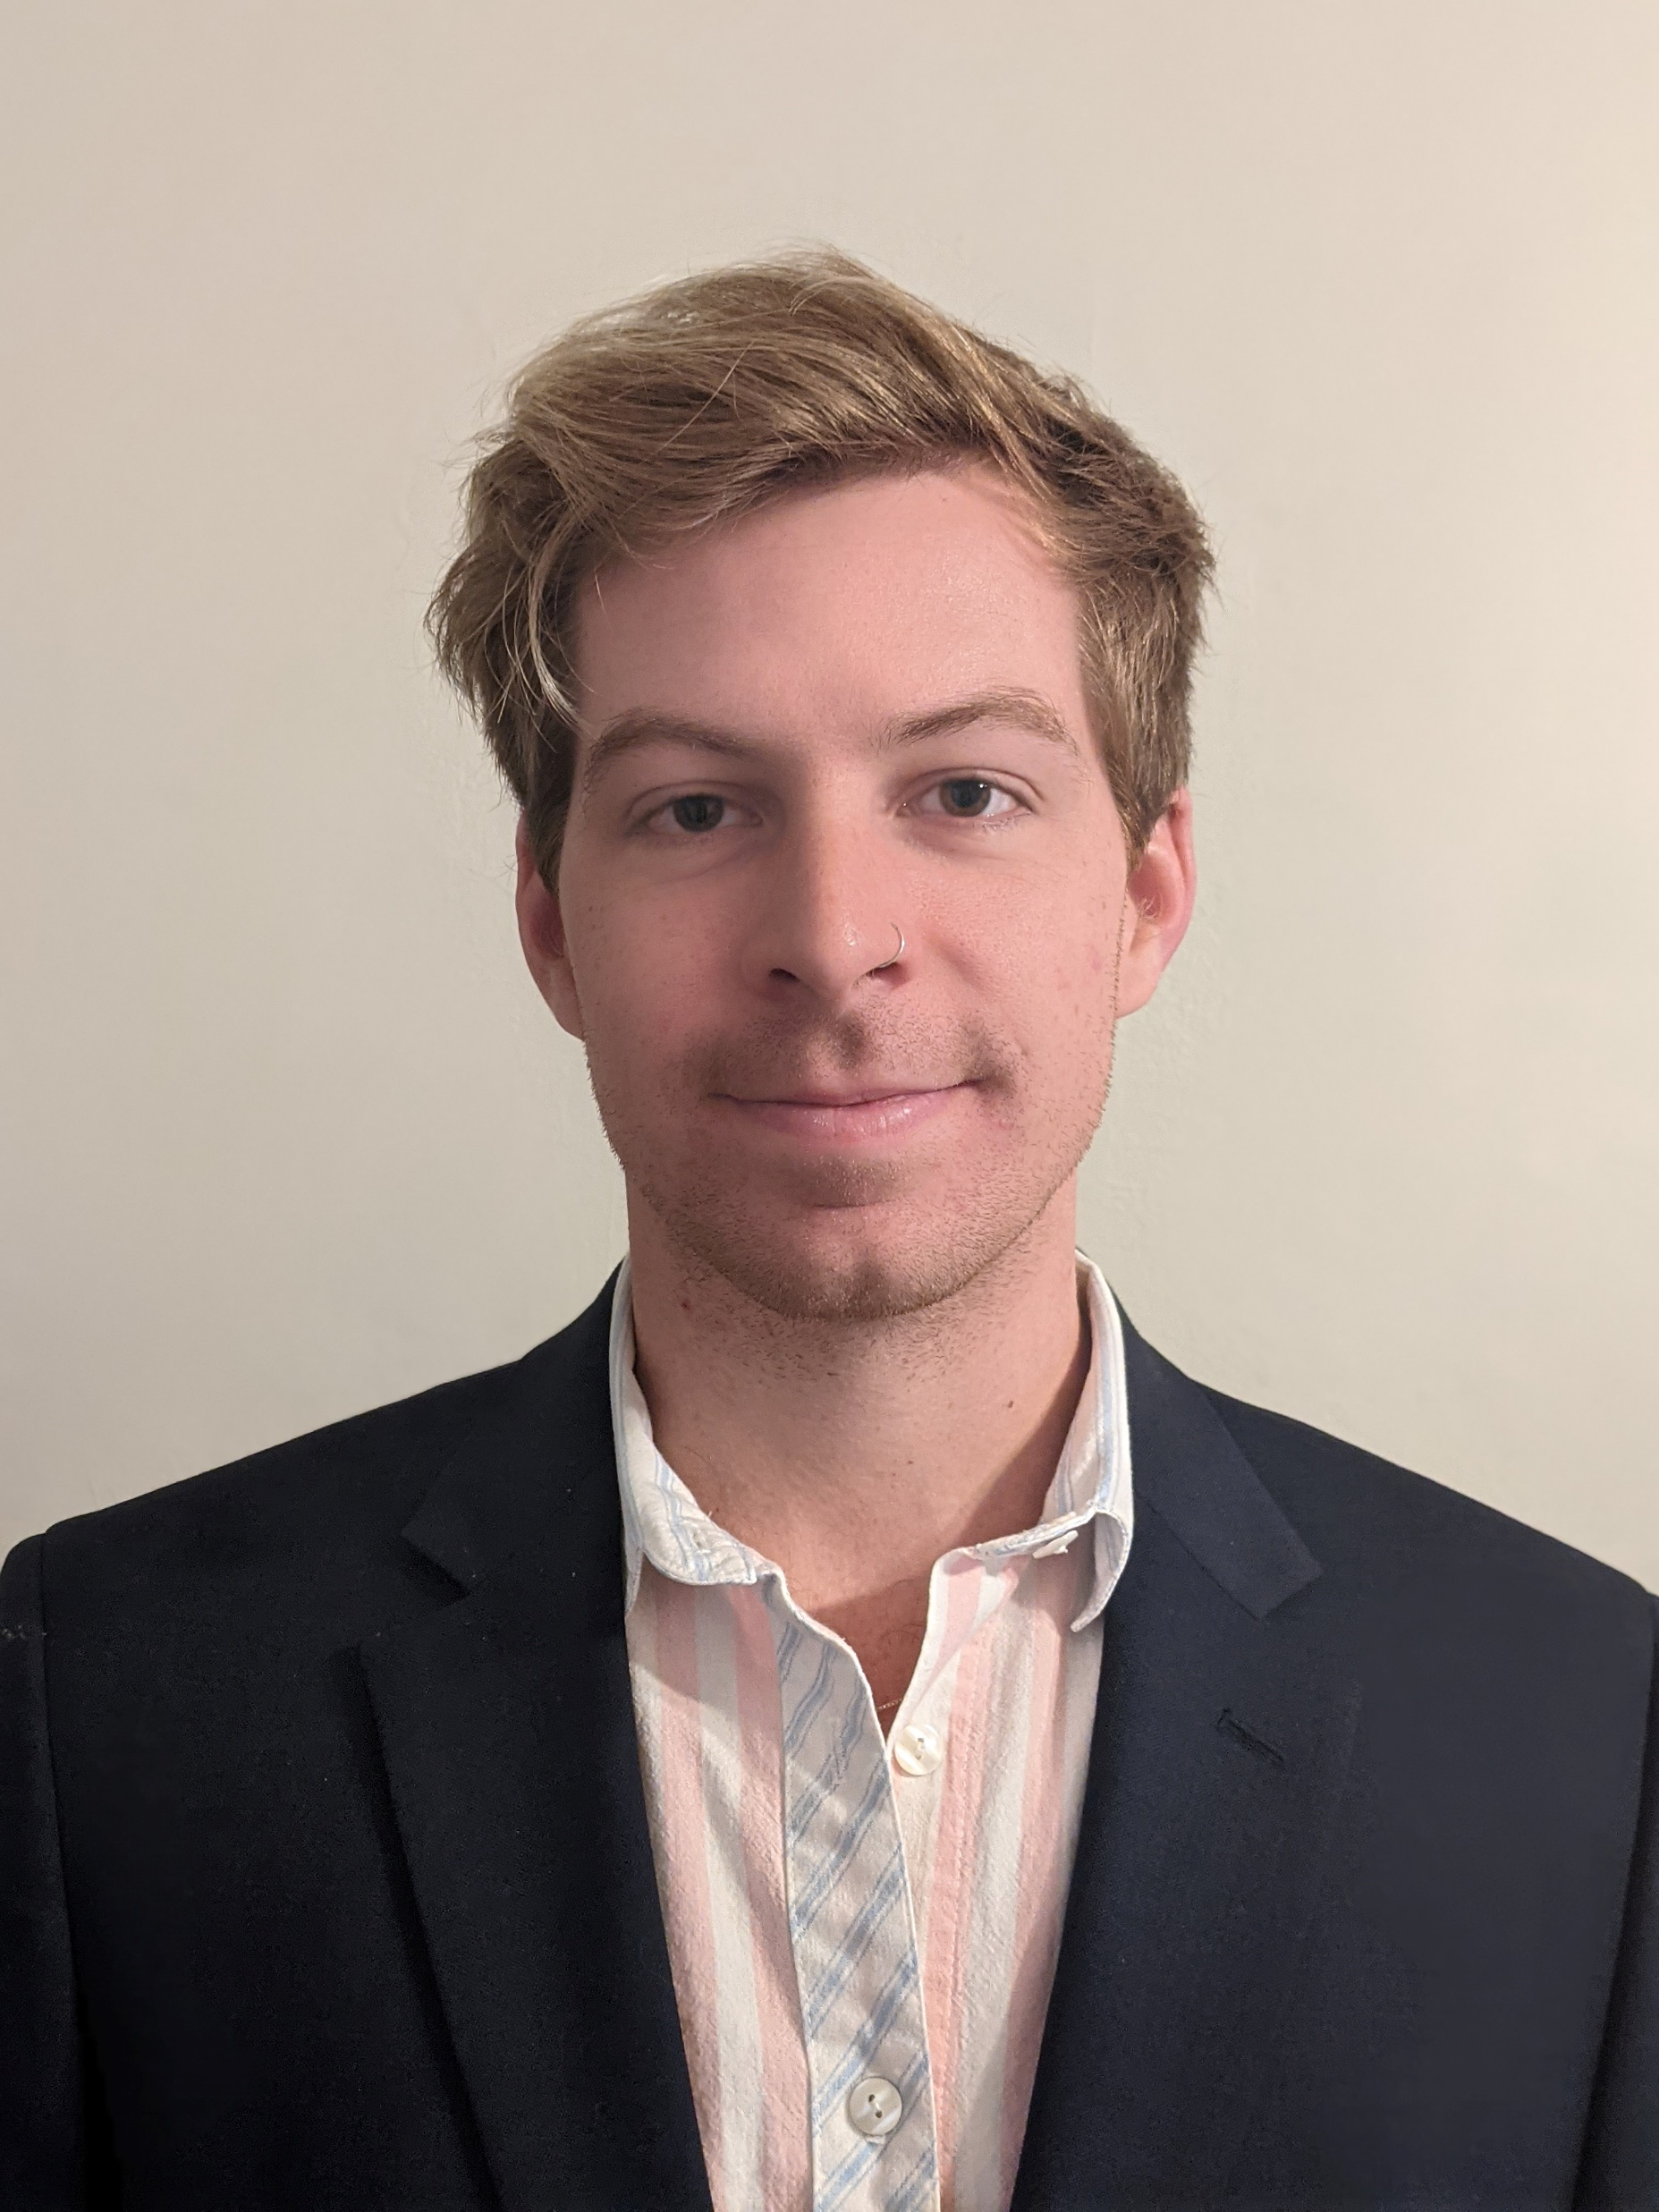


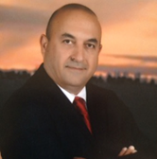
PGB EXPERT VOTING MEMBERS &
NON-VOTING MEMBERS
PGB EXPERT VOTING MEMBERS
Technical Steering Committees
PGB EXPERT NON-VOTING MEMBERS
Technical Steering Committees
Mr. Brad Bolliger
Co-Chair, NIEM Technical Architecture Committee TSC
Mr. Thomas Krul
Co-Chair, NIEM Business Architecture Committee TSC
Ms. Beth Smalley
Co-Chair, NIEM Management Office TSC
Dr. Scott Renner
Co-Chair, NIEM Technical Architecture Committee TSC
Mr. Kamran Atri
Co-Chair, NIEM Business Architecture Committee TSC
Notes:
Open Project Rules - OASIS Open (oasis-open.org)
5.1 Overall guidance for the Project is provided by its Project Governing Board (or PGB). The PGB is composed of one voting member from each Project Sponsor who elects to appoint a PGB member, and (a) if the PGB has one or more Technical Steering Committees, one voting expert representative from each TSC, elected or appointed by that TSC, or (b) otherwise, the PGB may appoint at least one and no more than two voting expert representatives from its community of contributors. The PGB may create additional non-voting PGB member seats for expert representatives to be elected by the TSC or appointed by the PGB. The PGB membership of all such members of any type is conditioned on satisfaction of the CLA requirement of Section 5.2. Voting status on the PGB may be affected by the provisions of Section 5.7.

Slide 10


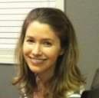
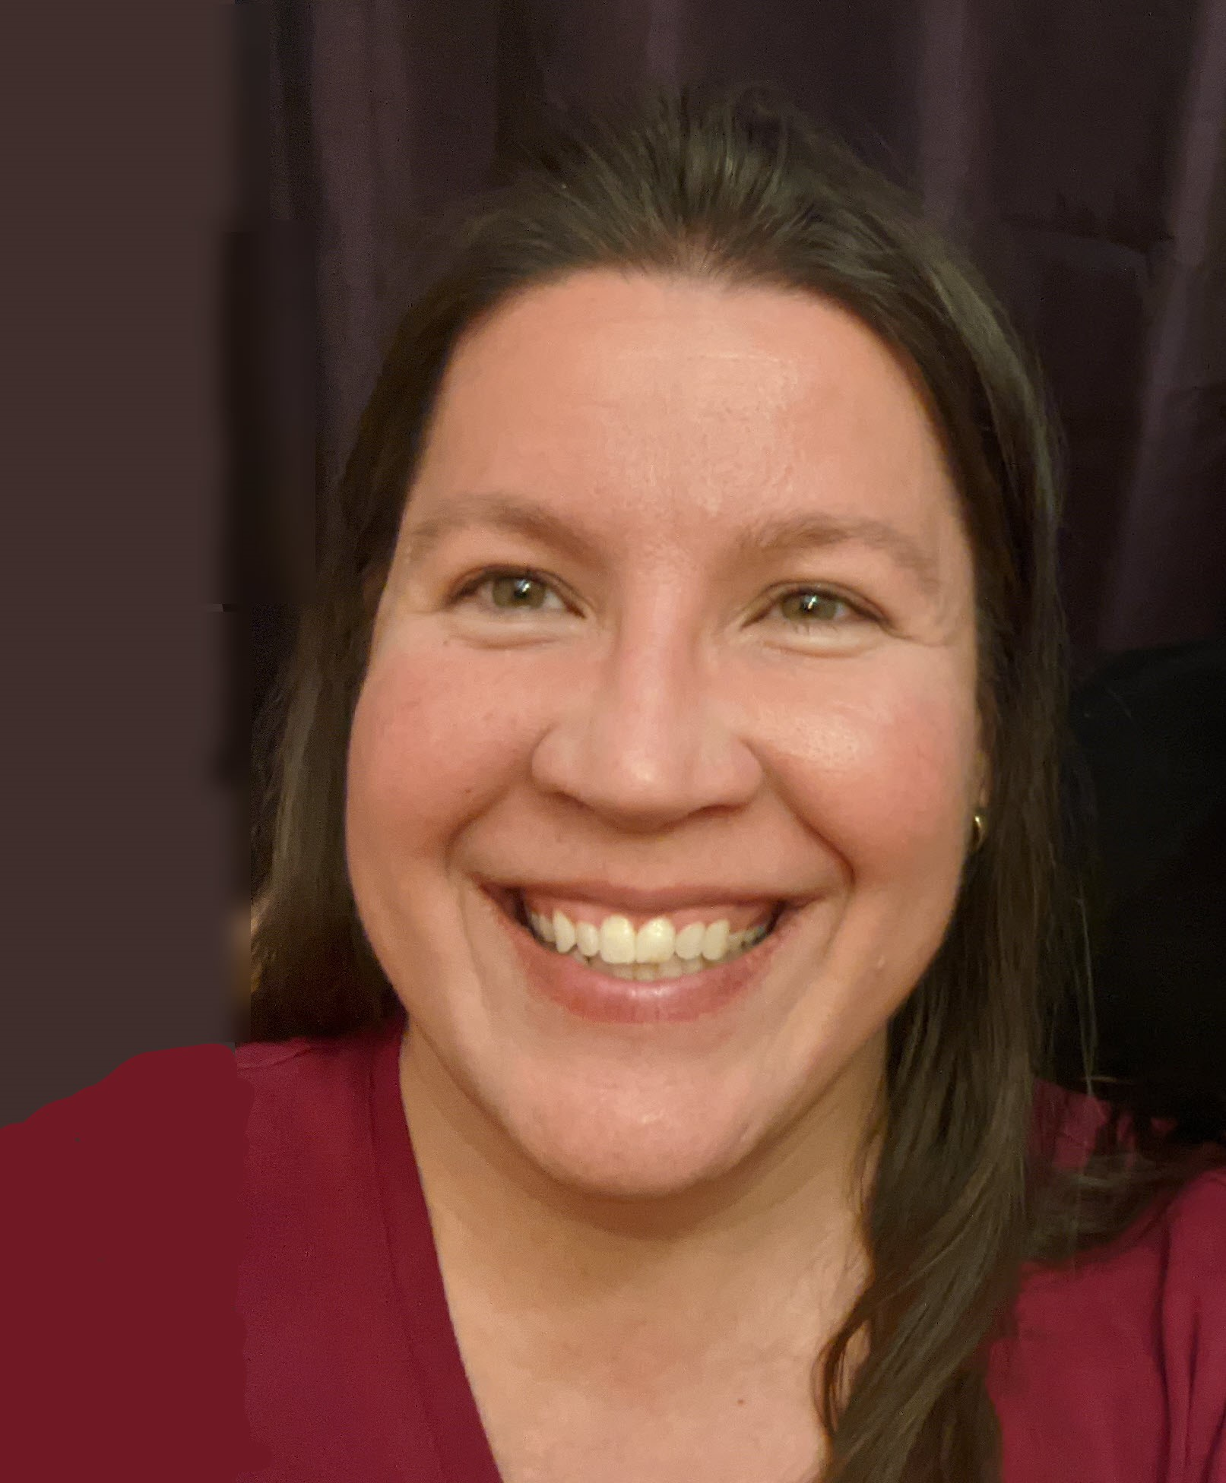

NMO, NBAC, & NTAC TSC Co-Chairs & OASIS Maintainers
TSC | Approved (TSC CHAIRS)
NMO TSC | Ms. Darcy Staley & Ms. Beth Smalley
NBAC TSC | Mr. Kamran Atri & Mr. Thomas Krul
NTAC TSC | Dr. Scott Renner & Mr. Brad Bolliger
GitHub Repos | Primary | Alternates
NIEM Open | Ms. Christina Medlin, Mr. Aubrey Beach | Mr. Tom Carlson, Ms. Shunda Louis, Mr. Steve Sullivan (pgb-minutes)
NTAC-Admin | Dr. Scott Renner, Mr. Brad Bolliger | Mr. Aubrey Beach, Mr. Tom Carlson, Mr. Jim Cabral, Ms. Christina Medlin, Ms. Shunda Louis
NBAC-Admin | Mr. Steve Sullivan, Mr. Aubrey Beach | Ms. Shunda Louis, Ms. Christina Medlin
NMO-Admin | Ms. Darcy Staley, Mr. Aubrey Beach | Mr. Steve Sullivan, Ms. Shunda Louis
NTAC TSC
NBAC TSC
NMO
TSC
Christina Medlin
Aubrey Beach
Dr. Scott Renner
Brad Bolliger
Steve Sullivan
Darcy Staley

Slide 11
Proposed 30 January 2025 PGB Agenda
Call to Order
Admin
TEAMS Link
Meeting Etiquette
Note Takers
Roll Call & Introductions
Announcements
PGB Voting Members (Sponsors) & PGB Expert Voting Members (TSCs) & PGB Non-Voting Members (TSC Co-Chairs)
TSC Co-Chairs & NIEMOpen Maintainers
Approval of Agenda
Around-the-Horn – PGB Voting Members
Approval of Meeting Minutes from 14 November 2024
OASIS Staff / NIEMOpen Administrator Comments
Q4 2024 Financial Snapshot – Cathie Mayo (OASIS)
Sponsor Update – Holly Peterson
CY 2025 Tasks
5 Minute Break
Motions
Motion to Approve CY 2025 (Q 2 & 4) Revised PGB Meeting dates
A proposal of intent to proceed with:
Advancing NDR v6.0 PSD01 to PS, &
Upon approval of NIEM Model v6.0 PS02 proceed to advance to OS
Co-Chair Discussion
Updates
NTAC Update – Dr. Scott Renner
NBAC Update – Thomas Krul
NMO Update – Darcy Staley/Katherine Escobar
PGB Meeting Schedule
Other Business/Discussion
Action Items
Resources
Questions/Adjourn

Slide 12
Approval of Agenda
Chair: A Draft Agenda for the NIEMOpen 30 January 2025 Project Governing Board (PGB) Meeting was provided to PGB Voting Members as a readahead.
Chair: Are there any recommended changes to the agenda as distributed?
Chair: If there are no (further) changes, the agenda stands approved as (corrected).
?
Approve
Approve as Corrected
Notes:
Chair asks PGB to approve 25 January 2024 PGB Meeting AGENDA.

Slide 13

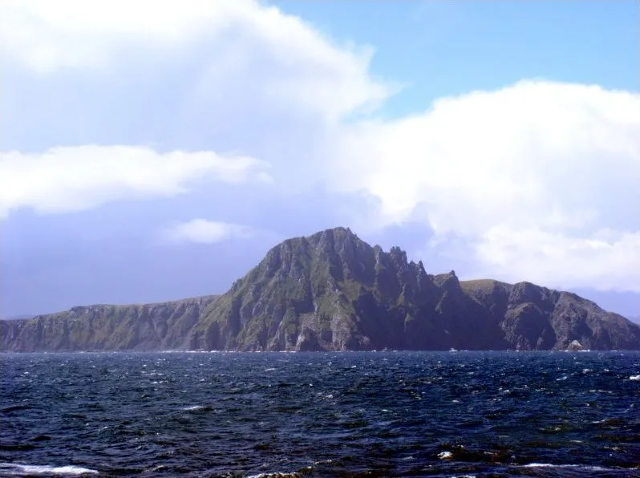
PGB MEMBERS: Around-the-horn
Notes:
The Go Around gives each person a brief turn to speak, without interruption. Everyone else listens. Also known as a Round Robin, Structured Go Around, or as going “Around the Horn”, this foundational meeting tool ensures that everyone can contribute their thoughts and comments.
The pictures on the slide is a metaphor for “Around the Horn”. It depicts the fictional ship, “the Black Pearl” transiting Cape Horn, the horn of Southern Chile. Located off the southern tip of mainland South America, it was named Hoorn for the birthplace of the Dutch navigator Willem Corneliszoon Schouten, who rounded it in 1616.

Slide 14
Approval of 14 November 2024 PGB Minutes
Chair: A Draft of the NIEMOpen 14 November 2024 PGB meeting minutes was provided to the PGB Voting Members as a readahead: Please let me know now if you found any errors: https://github.com/niemopen/oasis-open-project/blob/main/pgb-meeting-minutes/2024/14-November-2024/(DRAFT)%20NIEMOpen%20PGB%20Meeting%20Minutes%2014%20NOV%202024%20v1%2011-18-2024%20(1).docx
Chair: Are there any corrections to the minutes as distributed?
Chair: If there are no (further) corrections, the minutes stand approved as distributed (corrected).
?
Approve
Approve as Corrected
Notes:
Chair requests that 14 November PGB Meeting minutes be approved.

Slide 15
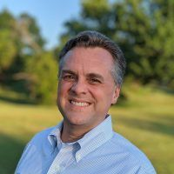
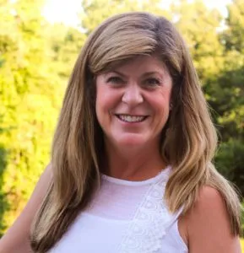
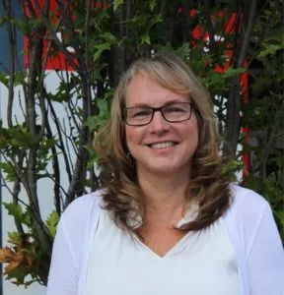

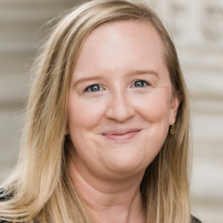

OASIS STAFF
Mr. Jim Cabral – OASIS Interim Executive Director
Ms. Cathie Mayo – OASIS Chief Financial Officer
Mr. James Bryce Clark – OASIS General Counsel
Ms. Jane Harnad – OASIS Head of Events
Ms. Kelly Cullinane – OASIS Senior Director of Standards Development
Ms. Holly Peterson – OASIS Business Development Manager
Notes:
Introduce OASIS Staff to new PGB Members

Slide 16

CY 2024 Q3 Financials
Ms. Cathie Mayo – OASIS Chief Financial Officer
Notes:
Chair introduces Cathie Mayo

Slide 17
CY 2024 Q4 Financials
Notes:
Chair introduces Cathie Mayo

Slide 18



















NIEMOpen Current SPONSORS
11 Sponsors, 3 Premier
Sponsors
JS J6
DHS S&T
CJIS (FBI)
GTRI
Equivant
NAJIS
IJIS
DOT
ODGA (Virginia)
BJS
NIJ
S&T
S&T
Premier
Premier
Premier
In Discussions
Microsoft
DHS OBIM
DND, Canada
DOJ
DHS OBIM
Department of National Defense
Expressed Interest
MITRE
Ernst & Young
DISA
Ms. Holly Peterson – OASIS Business Development Manager

Slide 19

CY 2025 NIEMOpen planning
Complete
Approve NIEMOpen NDR v6.0 Project Specification Draft (PSD01)
Submit NIEM Model v6.0 PS02 to PGB for approval and publication
Planned/ In Progress 2025
Submit NIEMOpen NDR v6.0 PSD01 as
Approve NIEM Model v6.0 PS02 as PS
Submit NIEM Model v6.0 PS02 as an OS
Solicit 3 statements of use
Start Model v6.1
Update Training Materials to reflect Model Version 6.0 Updates
Update/integrate LearnPress LMS w/Model Version 6.0
Complete transfer of github.io files to NIEMOpen
Recruit 3 new Premier Sponsors
Plan 2025 Symposium/Summit
Recurring/On-Going
Identify Potential Sponsors/Conduct Outreach
Conduct Synch w/ OASIS Staff as needed
Obtain Contributor License Agreements

Slide 20

BREAK

Slide 21
PGB Topics for Consideration & Vote
Motions
Motion to Approve CY 2025 (Q 2 & 4) Revised PGB Meeting dates
A proposal of intent to proceed with:
Advancing NDR v6.0 PSD01 to PS, &
Upon approval of NIEM Model v6.0 PS02 proceed to advance to OS
TSC Co-Chair Discussion
Updates
NTAC Update – Scott Renner
NBAC Update – Thomas Krul
NMO Update – Darcy Staley/Katherine Escobar

Slide 22
Motion to Approve CY 2025 (Q 2 & 4) Revised PGB Meeting dates
Chair: A proposal to approve changing CY 2025 Q 2 & Q4 PGB Meeting Dates from 24 April 2025 to 29 May 2025 and from 28 October 2025 to 13 November 2025 was submitted as a readahead to PGB Voting Members. Reason for change, chair unavailable during original dates.
Maker: (NMO-Beth Smalley) I motion that the following PGB Meeting Dates be accepted for the CY 2025:
SECOND?
Chair: (Debate) Do any of the members have comments on the proposal?
Chair: Conducts a Simple Majority Vote
Chair: Announces Vote
Resolution
Approve
Approve w/Comment
Table/Reject
Proposed “Revised” CY 2025 Meeting Dates
Q2 | MAY 29 | 2 – 4 PM | EDT
Q4 | NOV 13 | 2 – 4 PM | EDT
Notes:
1. The member (Beth Smalley) addresses the chair – “Madam Chairman”
2. The chair recognizes the member – “The chair recognizes Beth Smalley”
3. The member (Maker-Beth Smalley) makes a motion – I motion the PGB approve the following PGB meeting dates for CY 2025:
May 29, 2025, 2-4 PM EDT
November13, 2025, 2-4 PM EDT
4. Another member seconds the motion – SECOND
5. Chair: “It is moved and seconded to adopt the motion.
6. The members debate the motion
7. Chair: Those in favor of adopting the motion to approve say ‘Aye.’ [pause] Those opposed, say ‘No.’”
8. Chair: Announce the result
If no objections
Chair: Without objection, approved

Slide 23
Specification workflow and timeline
Request a spec template from OP Admin
Decide on editor(s)
Editor’s job is to capture the intentions of the project team/TSC
Editor’s Manual starting at https://docs.google.com/document/d/1lTartcAzlqidzrCxuXFFiwdRDKRipqMnNsMS24SZdjg/edit
Create Project Specification Draft (PSD)
PGB can decide to advance PS to OASIS for consideration as an OASIS Standard
Requires 3 Statements of Use and a Special Majority Vote run by OP Admin
60-day public comment period
The Project Specification (PS) is put to OASIS Members in a 14-day Call for Consent. If no objections, work becomes an OASIS Standard, eligible for submission to other SDOs
PSD produced with oversight of TSCs
TSC recommends PSD to PGB
PGB requests Special Majority Vote be run by OP Administrator
PS has the same standing as an OASIS Standard
7 days minimum - 2/3 must vote yes, no more than 1/4 nay votes
OP Admin publishes PS to the library and announces/promotes
Project Specification Approved by PGB
PGB approve PS as Candidate for OASIS Standard
OASIS Standard approved by members under Call for Consent
Project Specification
Draft(s)^{1,3}
DRAFT PSD
PGB Approval²
PS
PGB
Approval²
PS Candidate OS
PGB
Approval²
60 Day Public Review/ Comment
Call for
Consent
OASIS Standard
14 Days
Notice of Vote
14 Days
Notice of Vote
3 Statements of Use
GitHub Repo
OASIS Project Library
docs.oasis-open-projects.org
Special Majority Vote 7 Days
Working Draft
3-12 Months
Statements of Use
1-6 Months
2-3 Weeks Publish
Candidate Standard
60 Days
14 Days
Publication &
Announcement
1-2 Weeks
Notes:
NOTES:
TSCs may go through multiple iterations of PSDs before arriving at a final version.
There is a 2-week notice requirement before Voting to approve a PSD or PS or advance to OS.
Each work product proceeds through the process independently unlike Release or Group Releases.
DEFINITIONS:
“Project Specification” is one or more Release(s) or subsets of Release(s) of an OASIS Open Project properly prepared and nominated by the Project Governing Board (PGB) and approved as such by the Members of the PGB by a Special Majority Vote.
“Special Majority Vote” is a vote in which at least 2/3 (two thirds) of the eligible voters vote “yes” and no more than 1/4 (one fourth) of the eligible voters vote “no”. These numbers are based on the total number of eligible voters in the committee. Abstentions are not counted. For example, in a Technical Committee in which there are 30 Voting Members, at least 20 Voting Members must vote “yes” for a motion to pass; but if 8 or more vote “no” then the motion fails. All Special Majority Votes must be conducted via electronic ballot by the OASIS TC Administrator.
“OASIS Open Project Administrator” is the person or persons representing OASIS in administrative matters relating to Open Projects, Open Repositories, or Project Governing Boards. All official communications must be sent to op-admin@oasis-open.org.
OPEN PROJECT LIGHTWEIGHT RULES
11. Progression of Project Work
11.1 In addition to making available the contributions provided by Contributors, via their Project Repositories, Projects may designate specific portions of their output as official Releases, Group Releases, Project Specification Drafts or Project Specifications, and nominate them for further advancement, on the terms set forth in Sections 11, 12, 13 and 14.
12.2 Where the PGB or a consensus among the Contributors indicates that a specific set of contributions should be formally considered as a Release, Group Release, Draft Project Specification or Project Specification, then in preparation for that consideration, the Maintainers shall arrange the relevant material in the relevant Project Repository or repositories so that the set can be accessed and referenced as a distinct branch (a Designated Branch).
12. Releases and Group Releases
12.1 Releases. The PGB may act to approve a Designated Branch as an official Release of the Project, after giving notice to all Contributors via the Project Tools at least fourteen days prior to initiating a PGB vote or consensus call. Such approval decisions are subject to the process, notice and transparency provisions of these rules. Any product of the Project that is composed from contributions to the Project Repositories, of any nature, is eligible for approval as a Release of the Project.
12.2 Group Releases. When desirable to aggregate outputs, the PGB may act to approve any set of the Project’s Releases or subsets of Releases as an official Group Release of the Project, after giving notice to all Contributors via the Project Tools at least fourteen days prior to initiating a PGB vote or consensus call. Such approval decisions are subject to the process, notice and transparency provisions of these rules. Group Releases may include multiple Releases that bear different Applicable Licenses. Aggregate contributions by Maintainers or others which are prepared as potential Project Specifications should instead be approved as Project Specification Drafts, as provided below.
12.3 Licensing. Releases and Group Releases bear only the license rights and covenants provided for each of the contributions included there, as evidenced by the relevant repositories’ Applicable License(s) and the CLAs.
13. Project Specifications
13.1 In order to progress a Release or Group Release by the Project as a Project Specification Draft (or PSD) or a Project Specification (or PS), the PGB and the contents of the release(s) must satisfy the additional criteria of this Section.
13.2 In order to be advanced through the approval process, a proposed Project Specification must conform to the Project Specification template provided by the Open Project Administrator, which includes methods for indicating the relevant Designated Branches and Applicable Licenses. Proposed Project Specification Drafts also should conform to that template, to the extent possible.
13.3 Project Specification Drafts. A PGB having at least Project Approval Minimum Membership may act to approve any set of contributions to the Project, including from its Releases or Group Releases, as an official Project Specification Draft, after giving notice to all Contributors via the Project Tools at least fourteen days prior to initiating a PGB vote or consensus call. Such approval decisions are subject to the process, notice and transparency provisions of these rules.
13.4 Project Specifications. A PGB having at least Project Approval Minimum Membership may act to approve any Project Specification Draft as a Project Specification, by satisfying each of the following requirements:
(a) Written notice of that nomination must be given by the PGB to all those involved with the Project and the Open Project Administrator at least fourteen days prior to initiating a ballot. The ballot must be conducted by a Special Majority Vote of the PGB. The approval decision is subject to the process, notice and transparency rules set forth in these rules and the content requirements noted below.
(b) Any machine-executable instructions in a specific computer language (code) that are included in the Project Specification must be composed only of one or more Releases or Group Releases bearing Implementer-Class Licenses.
(c) Any guidance, descriptions, processes, models for the behavior of a system or service, or other content that is not machine-executable, and is included in the Project Specification, must be composed only of contributions (which may include Releases or Group Releases) previously made to a Project Repository.
(d) The proposed Project Specification will be subject to review and confirmation of conformance by the Open Project Administrator before the approval ballot is opened.
13.5 Upon successful conclusion of the Special Majority Vote, the Open Project Administrator must give public written notice thereof, which constitutes approval, and thereafter will publish the Project Specification to the OASIS Library.
13.6 Licensing. Project Specifications bear the license rights and covenants provided for each contribution included there, as evidenced by the relevant repositories’ Applicable License(s) and the CLAs, as well as the Specification Non-Assertion Covenant. Project Specifications may bear more than one Applicable License, when composed from Releases or Group Releases from multiple Project Repositories that have different Applicable Licenses.
13.7 Implementations of all kinds are welcome (partial or complete; prototype, proof-of-concept, example, model, or reference implementations), provided that PGBs may not designate any single implementation of a Project Specification as exclusive or privileged.
14. OASIS Standard Approval and External Submissions
Project Specifications are eligible for and may be submitted for approval as OASIS Standards, under the following conditions:
(a) After three Statements of Use referencing the PS have been presented to the PGB, a PGB having at least Project Approval Minimum Membership may approve the PS as a candidate for OASIS Standard in the same manner, and subject to the same requirements, as apply to Committee Specifications as provided in Section 3.8 Approval of an OASIS Standard of the OASIS TC Process. Procedural requirements applicable to TCs in that rule apply to the PGB for this purpose, including the Special Majority Vote required to nominate a Project Specification for OASIS Standard. However, a candidate for OASIS Standard submitted by an Open Project shall be subject to the distinct licensing terms in these rules, and not the licensing terms in the OASIS IPR Policy for TCs.
(b) Upon a successful conclusion of that PGB vote and all other requirements, the OASIS TC Administrator shall proceed with public review and a call for consent as provided in Sections 3.8.2 and 3.8.3 of the OASIS TC Process. An OASIS Standard submitted by an Open Project and approved as provided above is eligible for further external submissions as provided in and subject to the requirements in the OASIS Liaison Policy. The PGB must have at least Project Approval Minimum Membership at the time of any such action or approval; the other procedural requirements applicable to TCs in that policy apply to the PGB for this purpose.

Slide 24
Motion to Approve CY 2025 (Q 2 & 4) Revised PGB Meeting dates
Chair: A proposal signaling PGB intent to proceed was submitted as a readahead to PGB Voting Members. The proposals are :
Advance NDR v6.0 PSD01 to PS, &
Upon approval of NIEM Model v6.0 PS02 proceed to advance to OS
Maker: (NMO-Beth Smalley) I motion that the following proposals are approved:
Advance NDR v6.0 PSD01 to PS, &
Upon approval of NIEM Model v6.0 PS02 proceed to advance to OS
SECOND?
Chair: (Debate) Do any of the members have comments on the proposal?
Chair: Conducts a Simple Majority Vote
Chair: Announces Vote
Resolution
Approve
Approve w/Comment
Table/Reject
Notes:
1. The member (Beth Smalley) addresses the chair – “Madam Chairman”
2. The chair recognizes the member – “The chair recognizes Beth Smalley”
3. The member (Maker-Beth Smalley) makes a motion – I motion the PGB approve the following proposals:
Advance NDR v6.0 PSD01 to PS, &
Upon approval of NIEM Model v6.0 PS02 proceed to advance to OS
4. Another member seconds the motion – SECOND
5. Chair: “It is moved and seconded to adopt the motion.
6. The members debate the motion
7. Chair: Those in favor of adopting the motion to approve say ‘Aye.’ [pause] Those opposed, say ‘No.’”
8. Chair: Announce the result
If no objections
Chair: Without objection, approved

Slide 25
NTAC Update - NDR v6.0 PSD01
NDR v 6.0 PSD01 Approved by PGB 20 Jan 2025 Vote
A major rewrite of NDR 5.0
A new abstract UML metamodel defining the information content of a NIEM model
Two concrete model formats: XSD and CMF
Two supported message formats: XML and JSON
Simplified conformance rules for message schemas
Changes to augmentation and metadata
More explanation, (slightly) less technical detail
PSD01 available: HTTPs://github.com/niemopen/niem-naming-design-rules
Motion to Advance NDR to Project Specification Approved by PGB 30 Jan 2025

Slide 26
NTAC Update - Niem Model v6.0 PS02
NIEM Model v 6.0 PS02 Approved by PGB 10 Feb 2025 Vote
Minor adjustments to the structures namespace to support NDR updates
Update internal draft version numbers
PSD01 available: XXXXXXXXXXXXXXXXXXXXX
Motion to Advance NIEM Model v6.0 PSD02 to OASIS Specification Approved by PGB 30 Jan 2025

Slide 27
NBAC TSC Update
Obtain 3 Statements-of-Use for NIEM Model v6.0
Advance impending NIEM Model Version 6.0 PS02 to OS
Onboard:
Analytical Laboratory Domain/Sub-Committee
Identity Management Domain/Sub-Committee
Assist Defense Forensics & Biometrics with content contributions
Assist Learning & Development Domain with vocabularies/content
Support Operational Energy initiative as needed

Slide 28
Nmo TSC Update
Moving Reveal Summit to Fall 2025
Potential “new” domains/sub-committees
Cyber – DC3 discussions to invigorate Cyber continue
Multilateral Interoperability Programme (MIP)/ MIP Information Model (MIM) discussions
https://www.mimworld.org/portal/projects/welcome/wiki/Welcome
Analytic Laboratories (AL) domain/sub-committee onboarding discussions continue
https://www.icln.org/
Progress
NDR v6.0 PSD01 approved
Model Version 6.0 PS02 special majority vote scheduled
API 2.0 work continues
Training updates reflecting Model Version 6.0 and NDR 6 continue
MilOps
Ongoing efforts (Model Content/MEPs)
DMDC
USMTF
DISA
USDOT Model Minimum Uniform Crash Criteria (MMUCC) updates
Notes:
MIM / MIP discussions ongoing, anticipate periodic meetings over next 6 months
Kamrin Atri or Andrew Scott to provide status of Analytic Laboratories domain and Identity Management efforts

Slide 29








Resources
Follow Us On Twitter
https://twitter.com/NIEMconnects?ref_src=twsrc%5Etfw
Katherine Escobar, katherine.b.escobar.civ@mail.mil, 757-203-8631
Git Repos
NIEMOpen: https://github.com/niemopen/
NTAC TSC
https://github.com/niemopen/ntac-admin
NBAC TSC
https://github.com/niemopen/nbac-admin
NMO TSC
https://github.com/niemopen/nmo-admin
NIEMOpen Slack Channel: https://niemopen.slack.com/
Mailing Lists
NIEMOpen: https://lists.oasis-open-projects.org/g/niemopen
PGB: https://lists.oasis-open-projects.org/g/niemopen-pgb
NTAC TSC: https://lists.oasis-open-projects.org/g/niemopen-ntactsc
NBAC TSC: https://lists.oasis-open-projects.org/g/niemopen-nbactsc
NMO TSC: https://lists.oasis-open-projects.org/g/niemopen-nmotsc
https://www.niem.gov/
https://niemopen.org/
https://www.linkedin.com/groups/1903175/profile
https://www.youtube.com/channel/UCg9qV22PXLBjG41hc-EwVrQ
IEPD/MEP REPO
MEP TOOL
CMF TOOL
NDR v6.0 PSD01
NIEM Model v6.0 PS02

Slide 30
PGB meeting Schedule
NEXT PGB Meeting
Thursday, 29 May 2025
Virtual Meeting 2 – 4 PM EDT
Virtual: MS TEAMS
CY 2025 Meeting Dates Revised
Q1 | JAN 30 | 2 – 4 PM | EST
Q2 | MAY 29 | 2 – 4 PM | EDT
Q3 | JUL 31 | 2 – 4 PM | EDT
Q4 | NOV 13 | 2 – 4 PM | EDT

Slide 31


Adjourn
Chair: Do any of the PGB members or our attending guests have any questions?
Chair: Meeting Adjourned

Slide 32
Backups

